Slide 1
Generic Learning Platform
Christopher Blank, Nathan Frazier, Paul Nixon, and Catherine Todd

Slide 2

Meet the Team
We took a democratic approach to the project.
Nathan Frazier- Lead Programmer
Christopher Blank- Programmer
Paul Nixon-Programmer
Catherine Todd-Programmer/Manager
We implemented a rapid prototyping as our lifecycle model

Slide 3

Project Details
Programming Language: C#
IDE: Visual Studio
Data Storage: Text docs
Version Control: GitHub

Slide 4
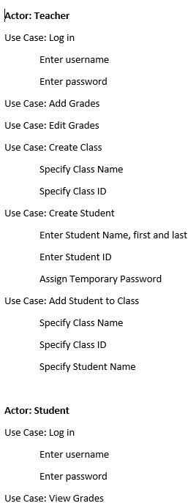
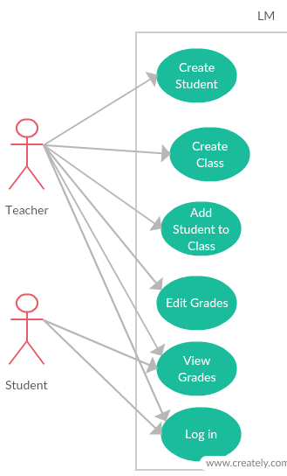
Requirements and Analysis
Plan: Compare each project prototype to the project requirements, specify one unmet requirement, then implement the requirement to the project
We identified the basic project requirements through a checklist
Primary use case diagram, and use cases

Slide 5
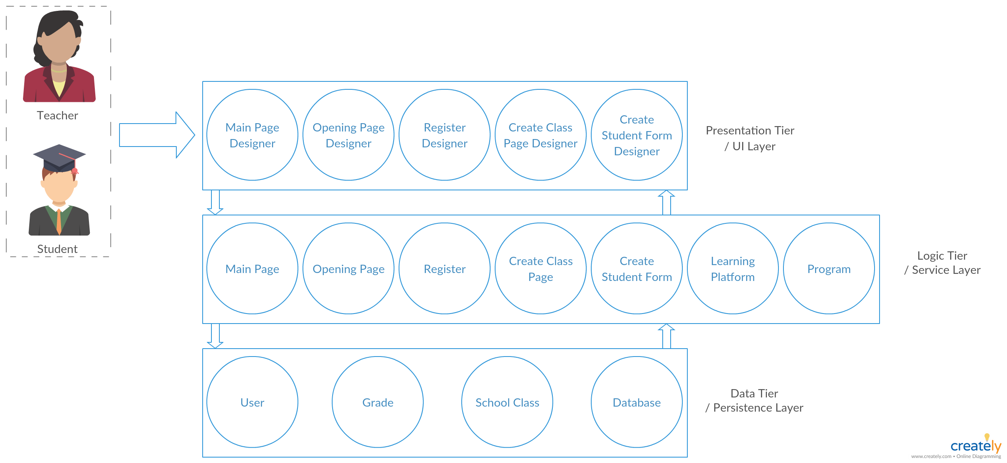
Design and Implementation-Project Architecture

Slide 6
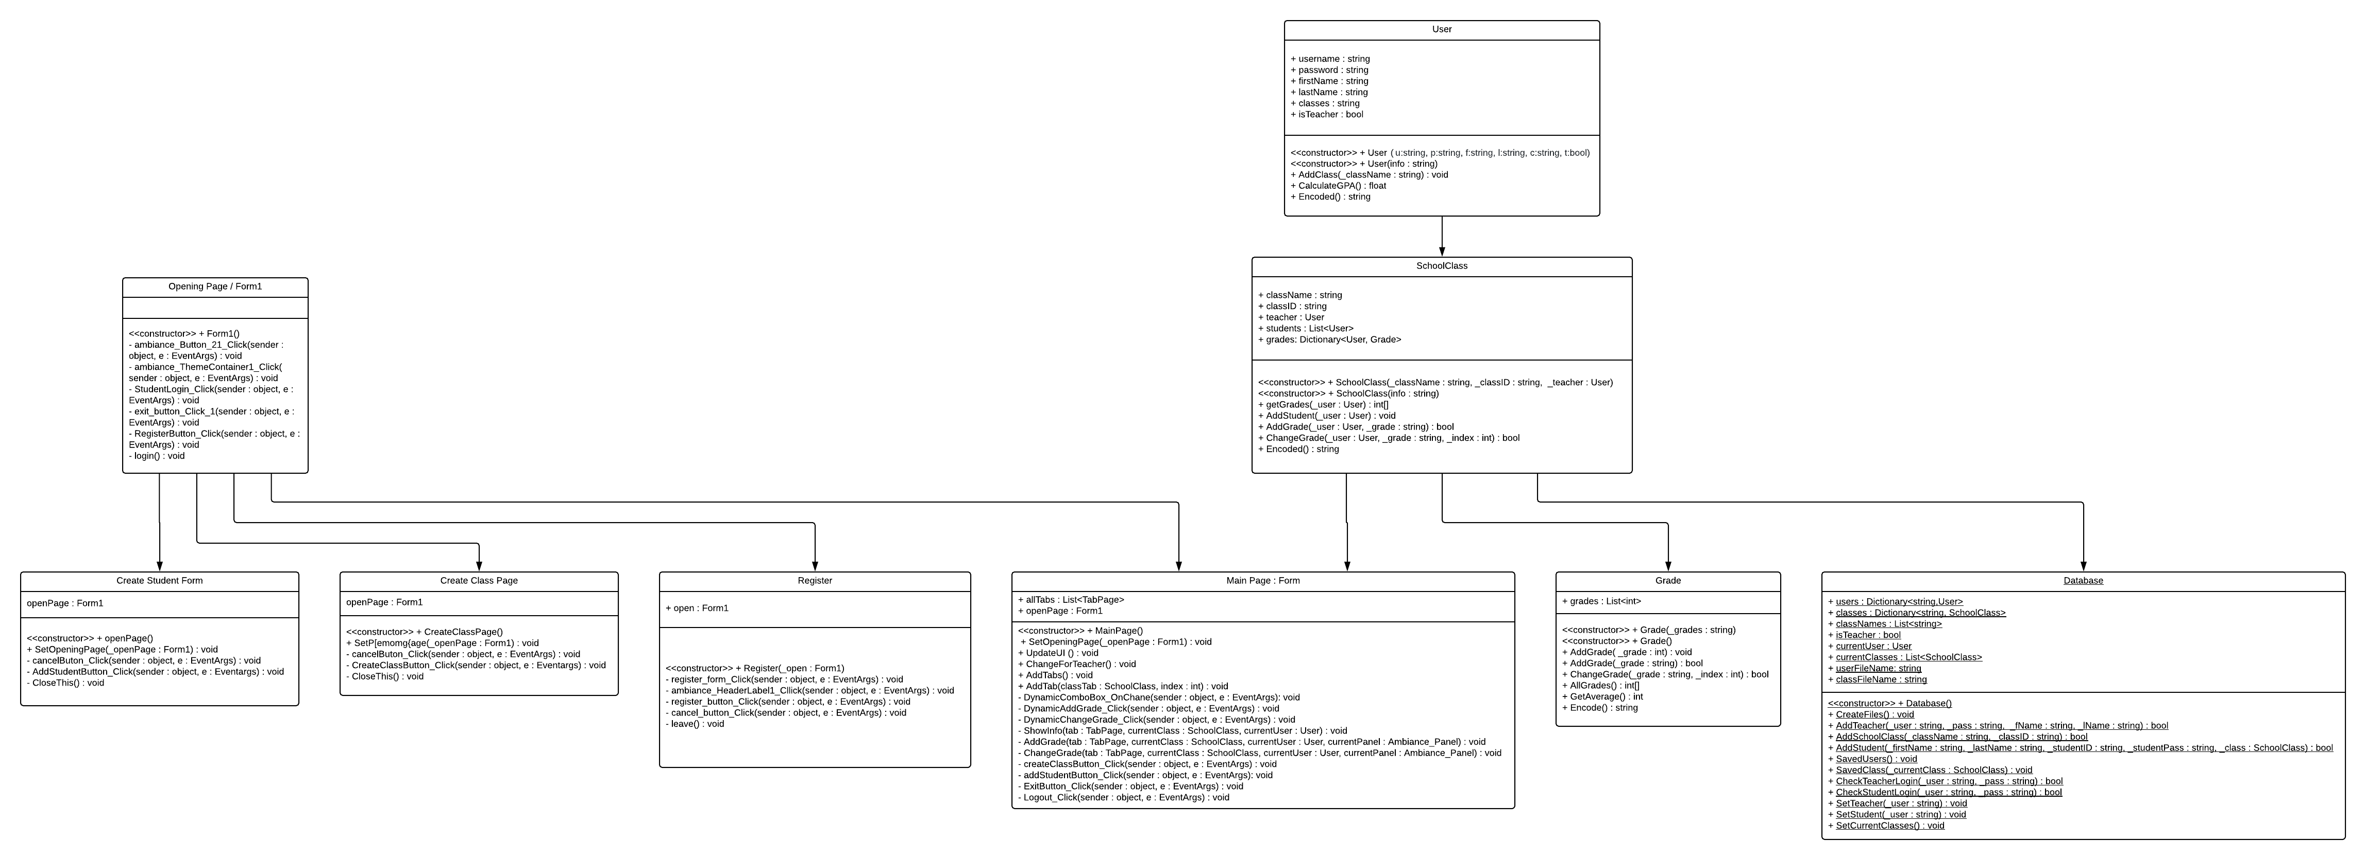
Design and Implementation-UML

Slide 7
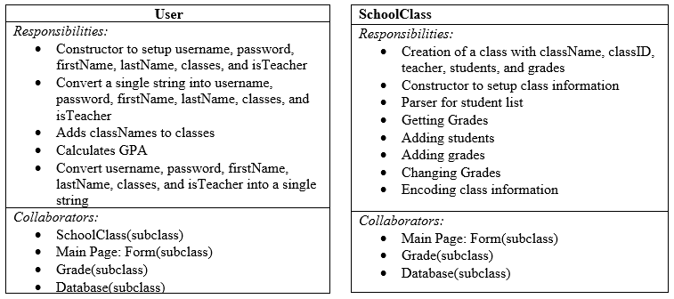
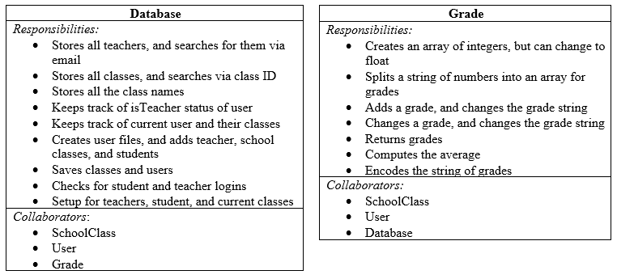
Design and Implementation-Data Tier CRC Cards

Slide 8
Demo
https://github.com/CS-3321/LearningPlatform

